Slide 1
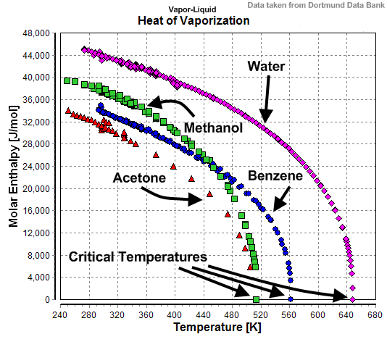
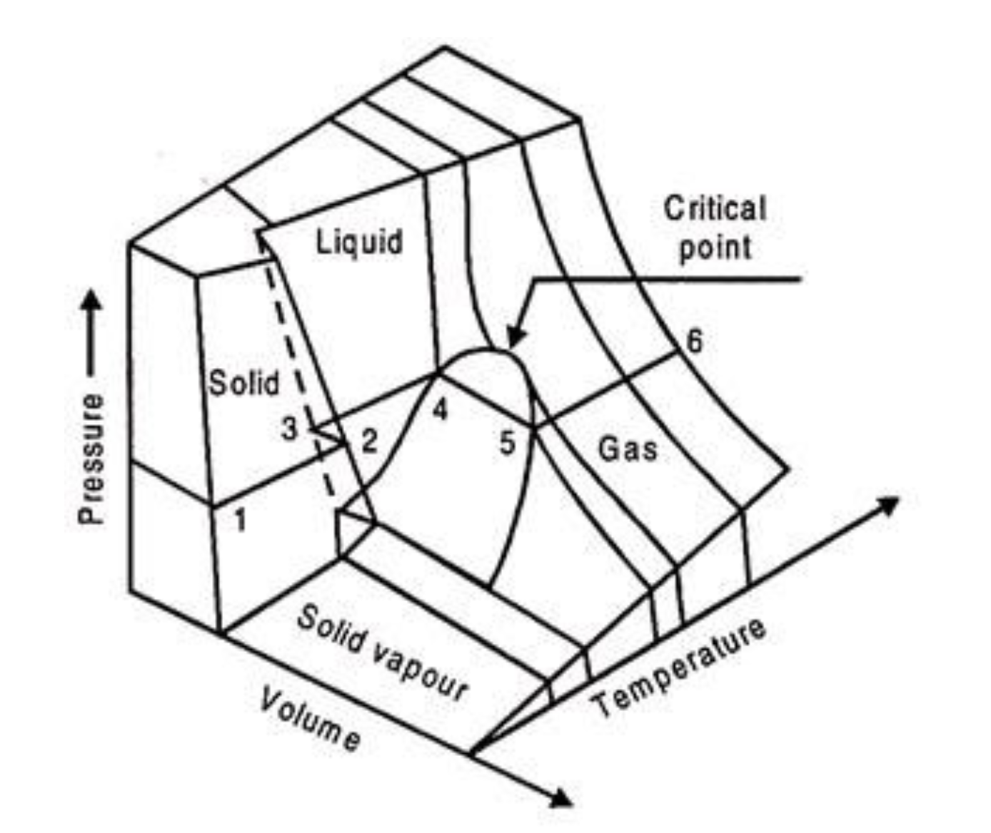
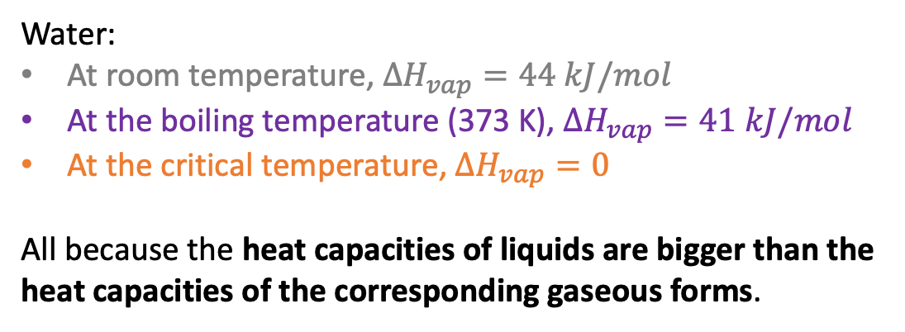
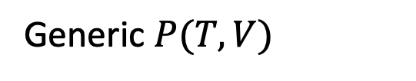
What we learned this week …
How $∆H_{vap}$ goes to zero at the critical temperature
Water:
At room temperature, $∆H_{vap}=44 kJ/mol$
At the boiling temperature (373 K), $∆H_{vap}=41 kJ/mol$
At the critical temperature, $∆H_{vap}=0$
All because the heat capacities of liquids are bigger than the heat capacities of the corresponding gaseous forms.
Is there a molecular perspective on this?
Generic $P(T,V)$

Slide 2
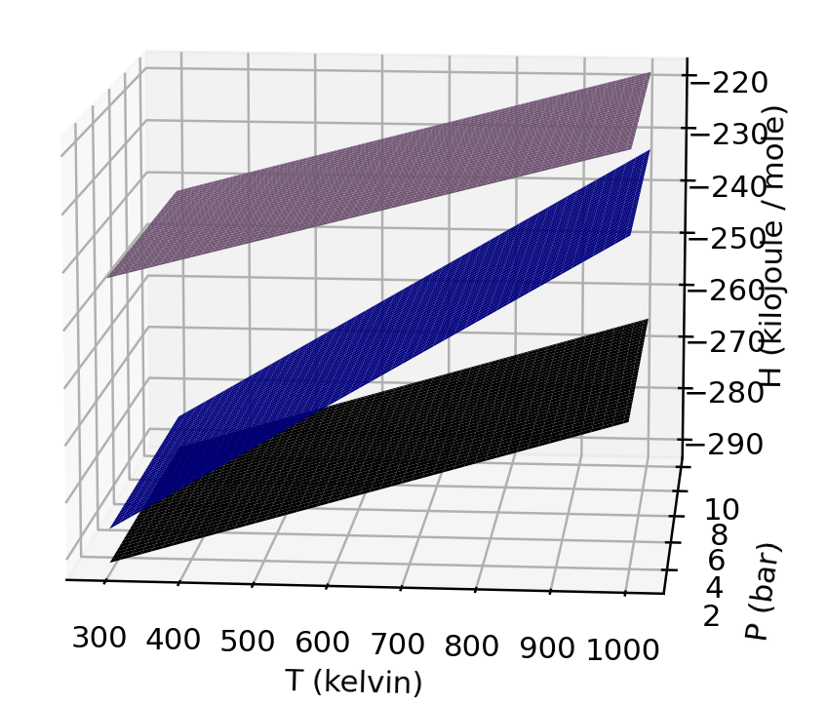



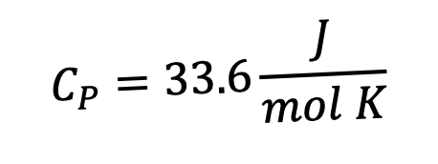

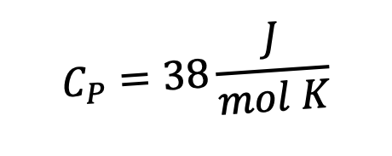

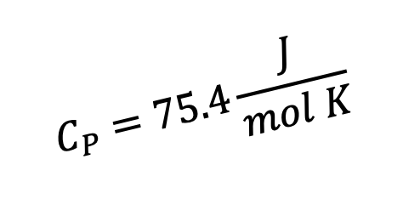

Definitions of $H_{vap}$, $H_{fus}$, and $H_{sub}$
$$C_{P}=33.6\frac{J}{mol K}$$
$$ΔH_{vap}$$
$$44.0\frac{kJ}{mol}$$
$$C_{P}=75.4\frac{J}{mol K}$$
H
$$ΔH_{sub}$$
$$50.0\frac{kJ}{mol}$$
$$ΔH_{fus}$$
$$6.0\frac{kJ}{mol}$$
$$C_{P}=38\frac{J}{mol K}$$
273 K
T
Clearly, the enthalpy of sublimation equals the sum of the enthalpies of fusion and vaporization (at a given temperature).

Slide 3
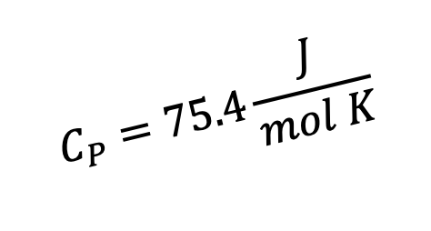
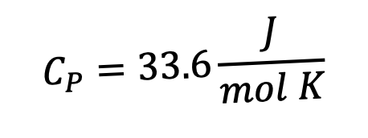
Changes in $H_{vap}$, $H_{fus}$, and $H_{sub}$
$$C_{P}=33.6\frac{J}{mol K}$$
$$ΔH_{vap}$$
$$44.0\frac{kJ}{mol}$$
$$C_{P}=75.4\frac{J}{mol K}$$
H
$$ΔH_{sub}$$
$$50.0\frac{kJ}{mol}$$
$$ΔH_{fus}$$
$$6.0\frac{kJ}{mol}$$
$$C_{P}=38\frac{J}{mol K}$$
273 K
T
What happens to $ΔH_{fus}$ at a lower temperature (like in the Arctic Ocean)?
What happens to $ΔH_{sub}$ at a (much) lower temperature (like on Mars!)?

Slide 4
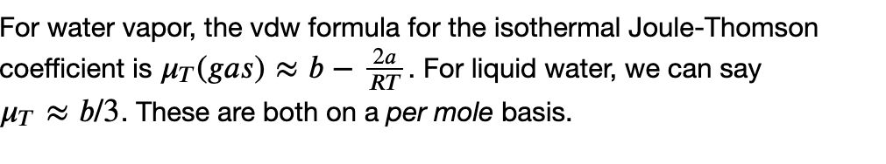
Changes in $H_{vap}$, $H_{fus}$, and $H_{sub}$
B
A
What happens to $ΔH_{vap}$ at a higher pressure (and room temperature)?

Slide 5
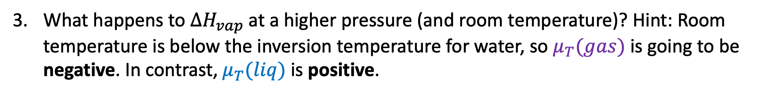
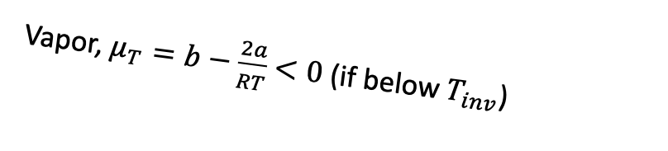
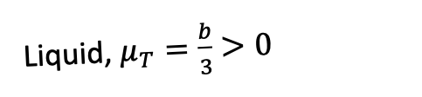
Changes in $H_{vap}$, $H_{fus}$, and $H_{sub}$
Vapor, $μ_{T}=b−\frac{2a}{RT}$ $<0$ (if below $T_{inv}$)
Liquid, $μ_{T}=\frac{b}{3}$ $>0$
B
A
P -->
B
A
What happens to $ΔH_{vap}$ at a higher pressure (and room temperature)? Hint: Room temperature is below the inversion temperature for water, so $μ_{T}(gas)$ is going to be negative. In contrast, $μ_{T}(liq)$ is positive.

Slide 6
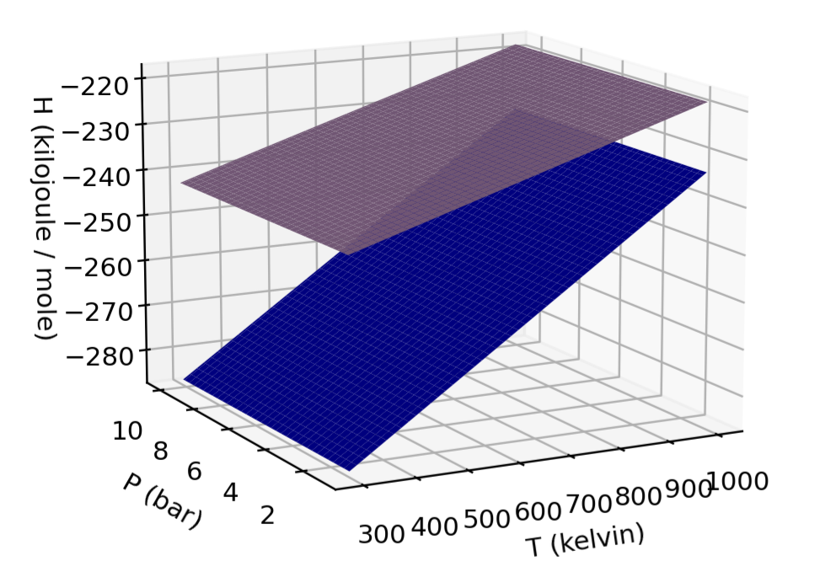
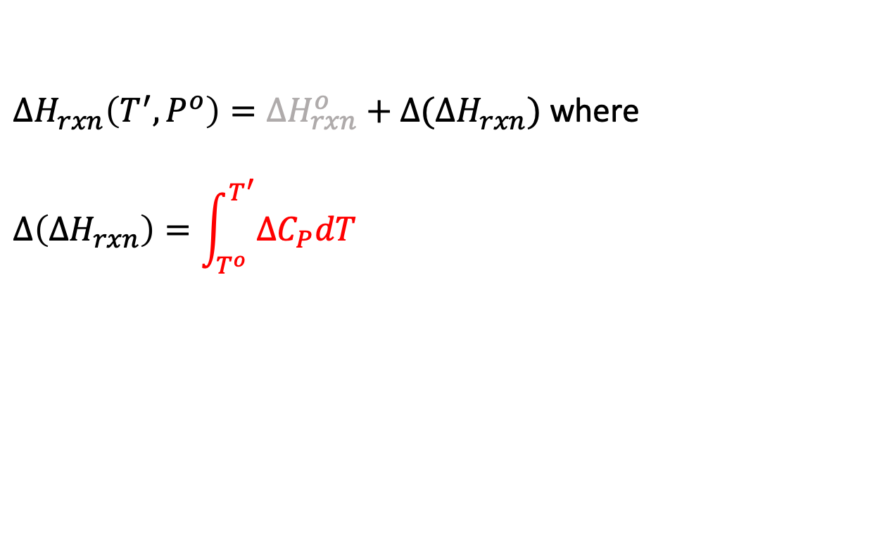



Kirchoff’s Law
Kirchoff’s Law is all about finding $∆H_{rxn}$ at a new temperature
$∆H_{rxn}\left(T^{′},P^{o}\right)=∆H_{rxn}^{o}+$ $∆(∆H_{rxn})$ where
$$∆\left(∆H_{rxn}\right)=\int_{T^{o}}^{T^{′}}{{∆C}_{P}dT}$$
${∆C}_{P}=C_{P}^{products}−C_{P}^{reactants}$
$$products$$
$$reactants$$

Slide 7
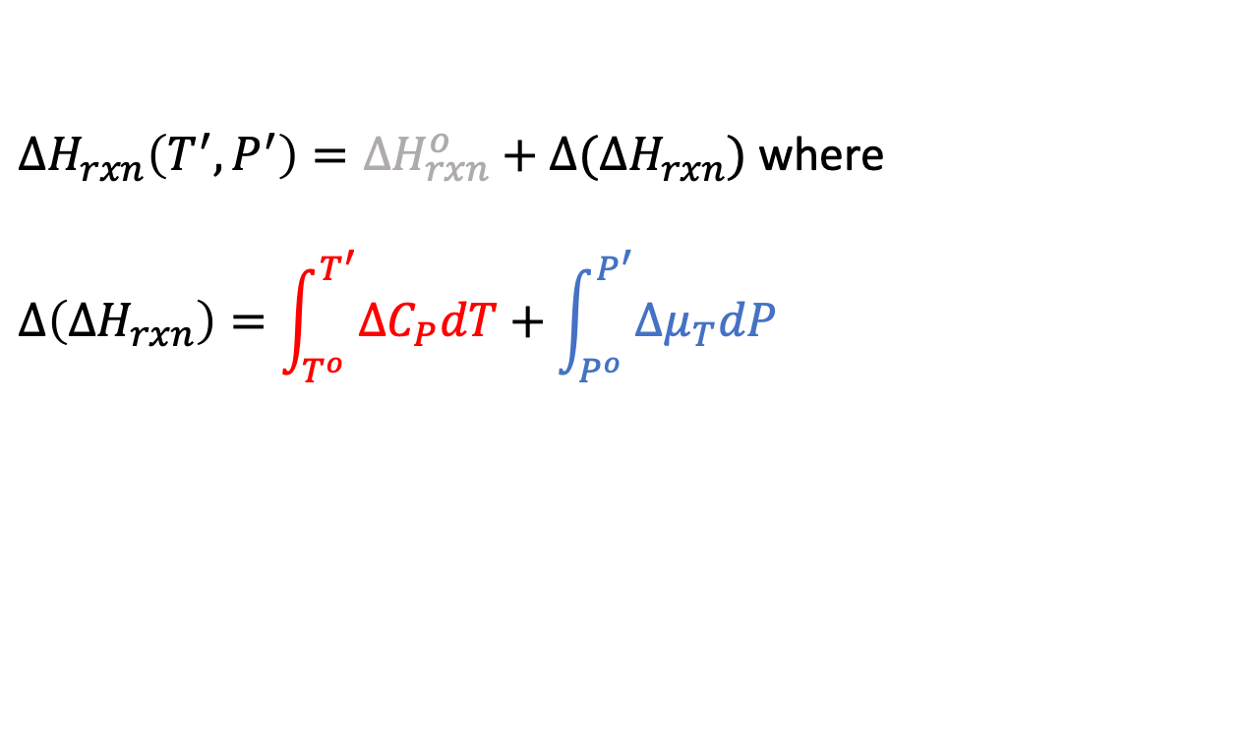

A generalization of Kirchoff’s Law
Generalized Kirchoff’s Law is all about finding $∆H_{rxn}$ at a new temperature & pressure
$∆H_{rxn}\left(T^{′},P^{′}\right)=∆H_{rxn}^{o}+$ $∆(∆H_{rxn})$ where
$$∆\left(∆H_{rxn}\right)=\int_{T^{o}}^{T^{′}}{{∆C}_{P}dT}+\int_{P^{o}}^{P^{′}}{{∆μ}_{T}dP}$$
${∆C}_{P}=C_{P}^{products}−C_{P}^{reactants}$
$$products$$
$$reactants$$
$${∆μ}_{T}=μ_{T}^{products}−μ_{T}^{reactants}$$

Slide 8
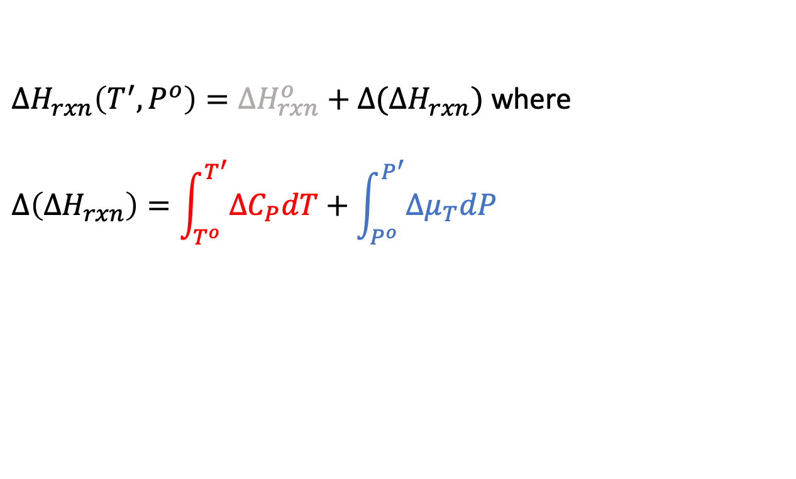
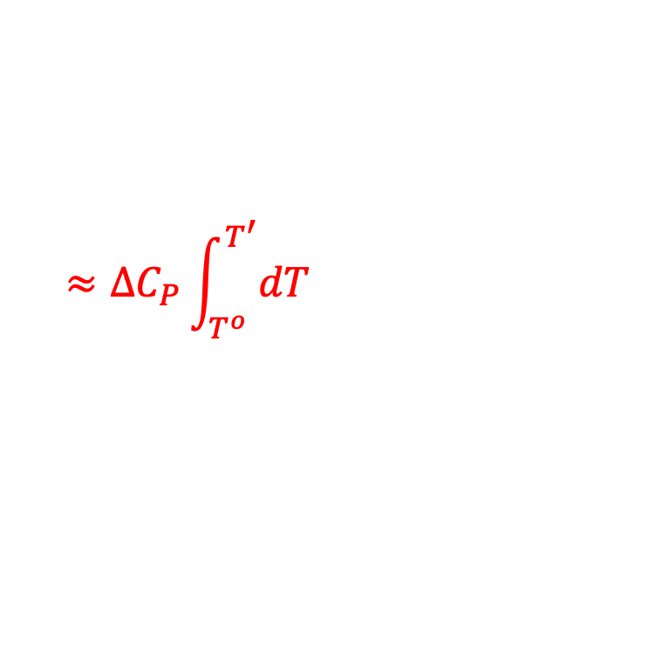
A generalization of Kirchoff’s Law
Generalized Kirchoff’s Law is all about finding $∆H_{rxn}$ at a new temperature & pressure
$∆H_{rxn}\left(T^{′},P^{o}\right)=∆H_{rxn}^{o}+$ $∆(∆H_{rxn})$ where
$$∆\left(∆H_{rxn}\right)=\int_{T^{o}}^{T^{′}}{{∆C}_{P}dT}+\int_{P^{o}}^{P^{′}}{{∆μ}_{T}dP}$$
${∆C}_{P}=C_{P}^{products}−C_{P}^{reactants}$
$$products$$
$$reactants$$
$$≈{∆C}_{P}\int_{T^{o}}^{T^{′}}{dT}$$
$${∆μ}_{T}=μ_{T}^{products}−μ_{T}^{reactants}$$

Slide 9
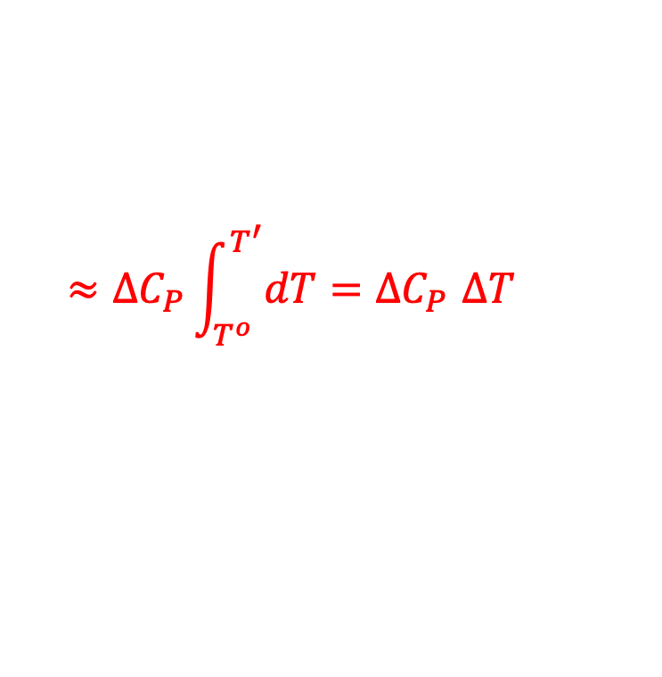
A generalization of Kirchoff’s Law
Generalized Kirchoff’s Law is all about finding $∆H_{rxn}$ at a new temperature & pressure
$∆H_{rxn}\left(T^{′},P^{o}\right)=∆H_{rxn}^{o}+$ $∆(∆H_{rxn})$ where
$$∆\left(∆H_{rxn}\right)=\int_{T^{o}}^{T^{′}}{{∆C}_{P}dT}+\int_{P^{o}}^{P^{′}}{{∆μ}_{T}dP}$$
${∆C}_{P}=C_{P}^{products}−C_{P}^{reactants}$
$$products$$
$$reactants$$
$$≈{∆C}_{P}\int_{T^{o}}^{T^{′}}{dT}{=∆C}_{P}∆T$$
$${∆μ}_{T}=μ_{T}^{products}−μ_{T}^{reactants}$$

Slide 10
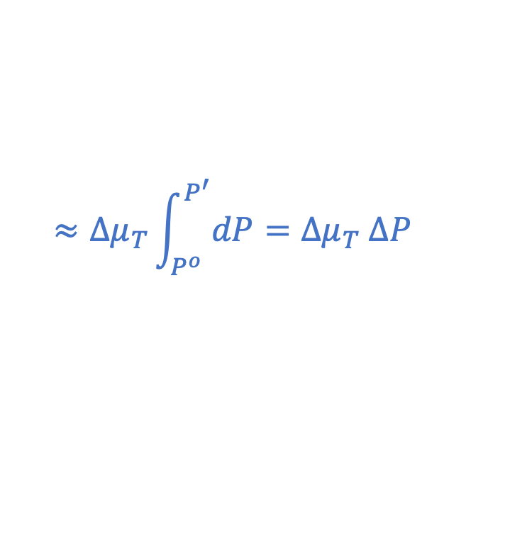
A generalization of Kirchoff’s Law
Generalized Kirchoff’s Law is all about finding $∆H_{rxn}$ at a new temperature & pressure
$∆H_{rxn}\left(T^{′},P^{o}\right)=∆H_{rxn}^{o}+$ $∆(∆H_{rxn})$ where
$$∆\left(∆H_{rxn}\right)=\int_{T^{o}}^{T^{′}}{{∆C}_{P}dT}+\int_{P^{o}}^{P^{′}}{{∆μ}_{T}dP}$$
${∆C}_{P}=C_{P}^{products}−C_{P}^{reactants}$
$$products$$
$$reactants$$
$$≈{∆μ}_{T}\int_{P^{o}}^{P^{′}}{dP}={∆μ}_{T} ∆P$$
$${∆μ}_{T}=μ_{T}^{products}−μ_{T}^{reactants}$$

Slide 11
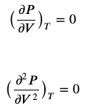




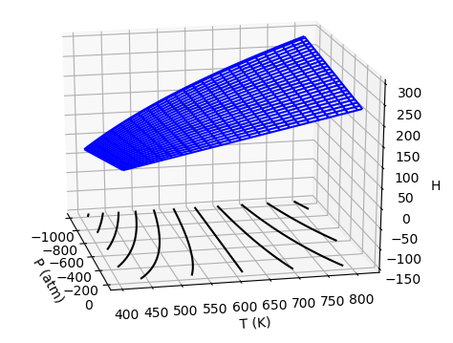
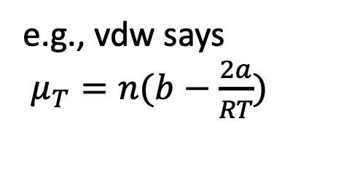


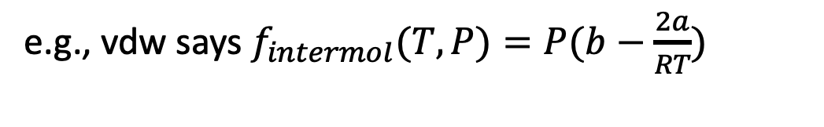
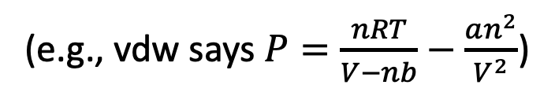
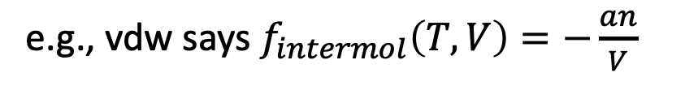

Don’t forget about our roadmap!
(e.g., vdw says $P=\frac{nRT}{V−nb}−\frac{an^{2}}{V^{2}}$)
(AnalyticalTcrit)
$P=P(T,V)$
$T_{crit}$, $V_{crit}$
(AnalyticalMu)
e.g., vdw says
$π_{T}=\frac{an^{2}}{V^{2}}$
e.g., vdw says
$μ_{T}=n(b−\frac{2a}{RT})$
Math
181
Math
180
(AnalyticalH)
Math
181
Math
180
e.g., vdw says $f_{intermol}\left(T,V\right)=−\frac{an}{V}$
e.g., vdw says $f_{intermol}(T,P)=P(b−\frac{2a}{RT})$
(VisualizingH)

Slide 12
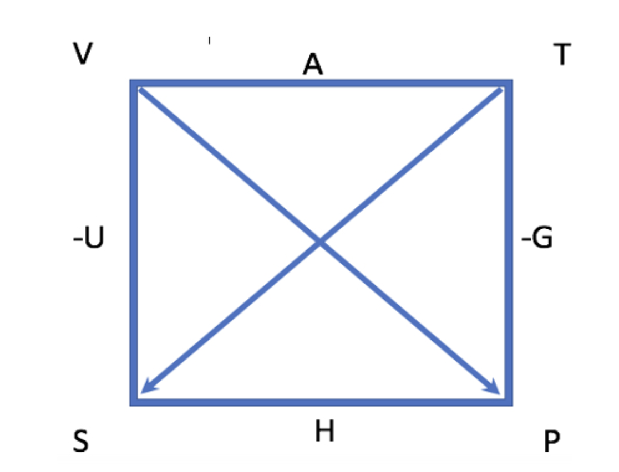
But there’s a piece of the roadmap we haven’t done yet
But not this:
We did this:

Slide 13
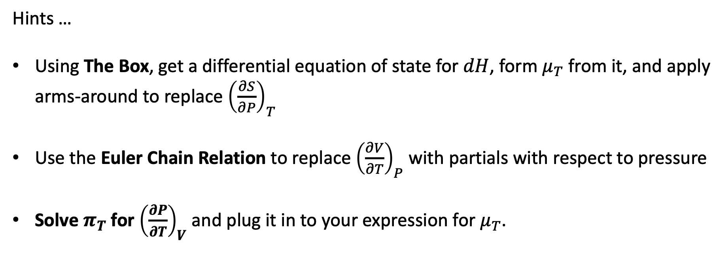

Deriving $μ_{T}=\frac{P+π_{T}}{{\left(\frac{∂P}{∂V}\right)}_{T}}+V$
Hints …
Using The Box, get a differential equation of state for $dH$, form $μ_{T}$ from it, and apply arms-around to replace ${\left(\frac{∂S}{∂P}\right)}_{T}$
Use the Euler Chain Relation to replace ${\left(\frac{∂V}{∂T}\right)}_{P}$ with partials with respect to pressure
Solve $π_{T}$ for ${\left(\frac{∂P}{∂T}\right)}_{V}$ and plug it in to your expression for $μ_{T}$.

